Slide 1

MINOR PROJECT- 2 (23ECSW304) Phase – 2 Review Under Guidance of Prof. Savita Bagewadi
UNDER WATER IMAGE RESTORATION
Department of Computer Science and Engineering,
KLE Technological University’s Dr. M. S. Sheshgiri College of Engineering and Technology, Belagavi

Slide 2
DETAILS OF THE TEAM
Team No. |  | MPB2-15
Div: |  | B
Sl. No. | Name |  | SRN.
1 | PRATHAM SHINDE |  | 02FE22BCS411
2 | ABHISHEK AJATDESAI |  | 02FE22BCS402
3 | OM KANGRALKAR |  | 02FE22BCS410
Department of Computer Science and Engineering,
KLE Technological University’s Dr. M. S. Sheshgiri College of Engineering and Technology, Belagavi

Slide 3
Problem Statement:
Underwater images often suffer from blurriness and color degradation (bluish-green) as depth increases. Underwater image restoration aims to produce clear and natural-looking images that accurately reflect the true underwater scene.
Department of Computer Science and Engineering,
KLE Technological University’s Dr. M. S. Sheshgiri College of Engineering and Technology, Belagavi

Slide 4
Objectives:
Improved Visibility: Reduce haze and scattering effects that obscure details, leading to a clearer and more visually interpretable image.
Enhanced Color Fidelity: Correct the dominant blue/green color cast caused by light scattering and restore a more accurate and balanced color representation of the underwater environment.
Department of Computer Science and Engineering,
KLE Technological University’s Dr. M. S. Sheshgiri College of Engineering and Technology, Belagavi

Slide 5
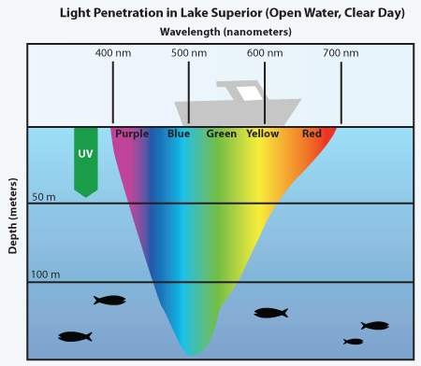
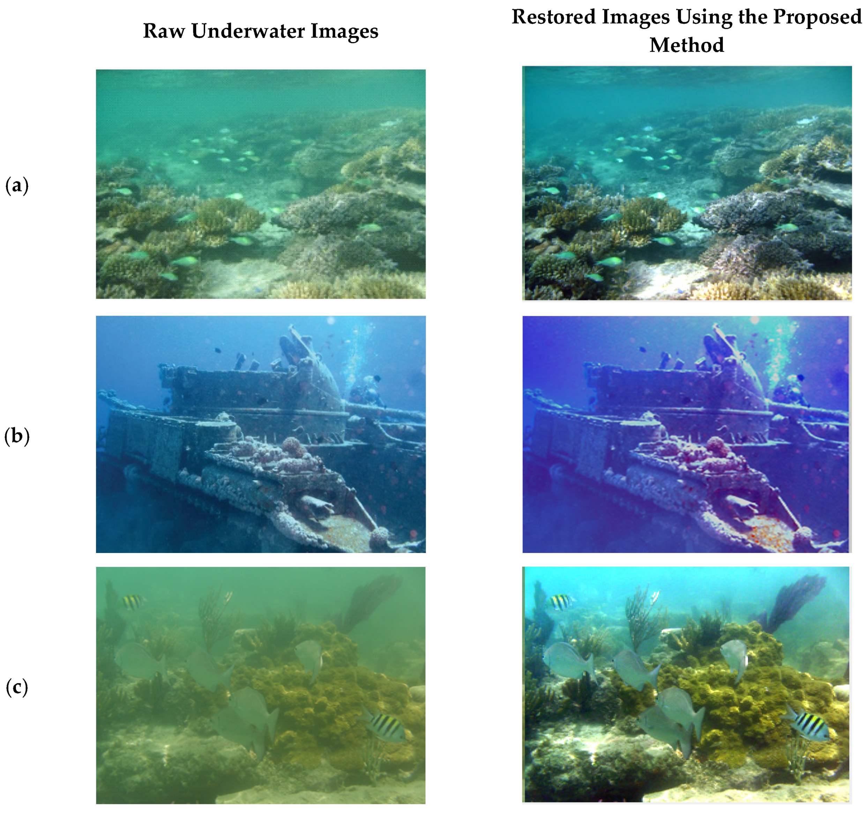
(Credit: Marine Dynamics https://marinedynamics.org/)

Slide 6
Parameters:
PSNR (Peak Signal-to-Noise Ratio):Measures the peak error between the restored image and the ground truth image.
SSIM (Structural Similarity Index Measure):Assesses the structural similarity between the restored image and the ground
Epochs: 500
Batch Size: 1
Learning Rate: 0.0005
Image Size: 256x256
Normalization: Dividing by 255.0 to scale pixel values between 0 and 1
Department of Computer Science and Engineering,
KLE Technological University’s Dr. M. S. Sheshgiri College of Engineering and Technology, Belagavi

Slide 7
Implementation:
Platform: Python 3.x, jupyter notebook
Libraries: PyTorch, OpenCV (cv2), pytorch_ssim.
Step 1: Data Preparation
Image Loading: Read images from the dataset using OpenCV.
Image Preprocessing: Resize and normalize images, convert color spaces if necessary.
Step 2: Model Architecture
Generator Network: U-shape Transformer architecture for restoring images.
Discriminator Network: PatchGAN architecture for distinguishing real and fake images.
Department of Computer Science and Engineering,
KLE Technological University’s Dr. M. S. Sheshgiri College of Engineering and Technology, Belagavi

Slide 8
Implementation:
Step 3: Training Process
Loss Functions
Adversarial Loss (GAN Loss): Encourages generator to produce realistic images.
Pixel-wise Loss: Minimizes pixel differences between restored and ground-truth images.
SSIM Loss: Maximizes structural similarity.
Department of Computer Science and Engineering,
KLE Technological University’s Dr. M. S. Sheshgiri College of Engineering and Technology, Belagavi

Slide 9
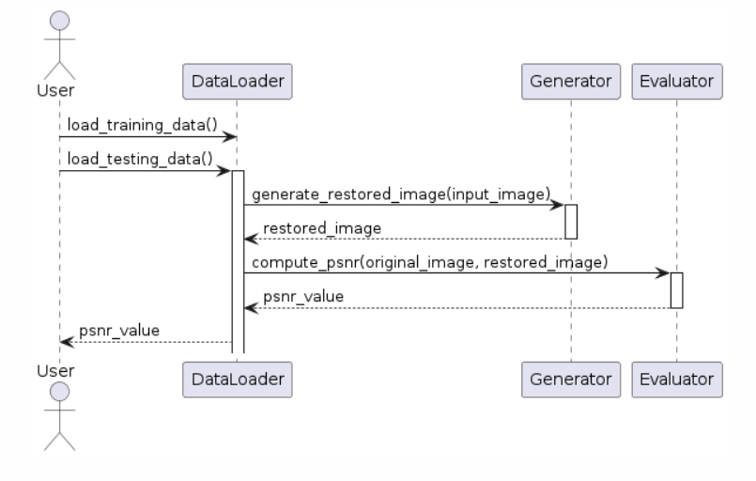
Sequence Diagram
Department of Computer Science and Engineering,
KLE Technological University’s Dr. M. S. Sheshgiri College of Engineering and Technology, Belagavi

Slide 10
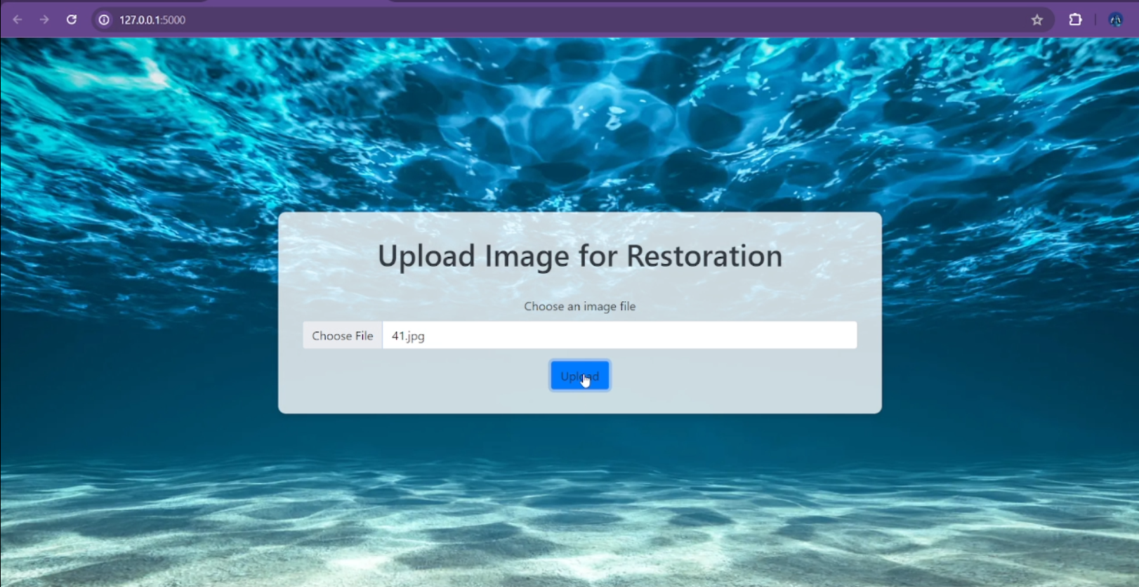
Department of Computer Science and Engineering,
KLE Technological University’s Dr. M. S. Sheshgiri College of Engineering and Technology, Belagavi

Slide 11
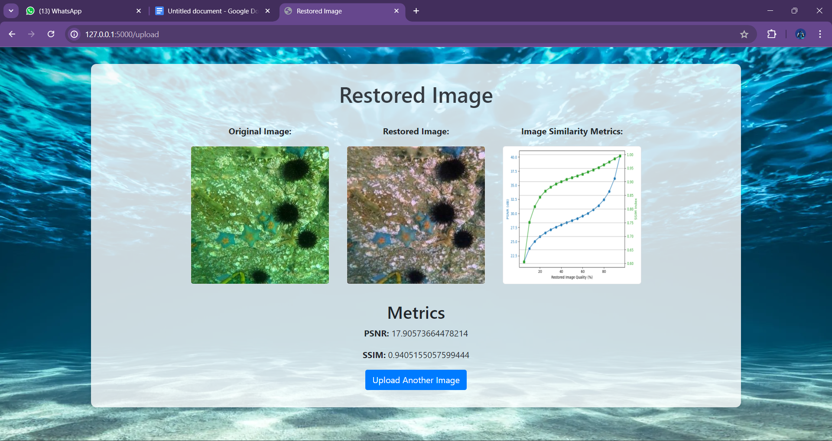
Department of Computer Science and Engineering,
KLE Technological University’s Dr. M. S. Sheshgiri College of Engineering and Technology, Belagavi

Slide 12
Thank you !
Department of Computer Science and Engineering,
KLE Technological University’s Dr. M. S. Sheshgiri College of Engineering and Technology, Belagavi

